Slide 1

Twitter Sentiment Analysis
Seminar- IT 290
Presented by:
Rakshatha Vasudev
B.tech 2nd year
Roll no.171IT131

Slide 2
Introduction
Sentimental analysis otherwise called opinion mining or data mining is the process of computationally determining the opinion or attitude of the writers as positive, negative or neutral.

Slide 3
Why…??
In many fields like business, politics and public actions, determining the sentimental analysis is very important.
On structured data analytics operation can be easily performed and the result can be obtained easily.
But in case of unstructured data from Email, Twitter etc., it is quite difficult to conclude the output because of various problems such as virtual noise effect and unspecific data

Slide 4
Real life applications
Is the product review positive or negative?
Based on a sample of tweets, how are people responding to this ad campaign/product release/news item?
How have bloggers' attitudes about the president changed since the election?

Slide 5
Twitter Sentiment Analysis
(Implementation)
Proposed Methodology
Data Collection
Pre-Processing
Feature-Extraction
Classification
Feature-Selection

Slide 6
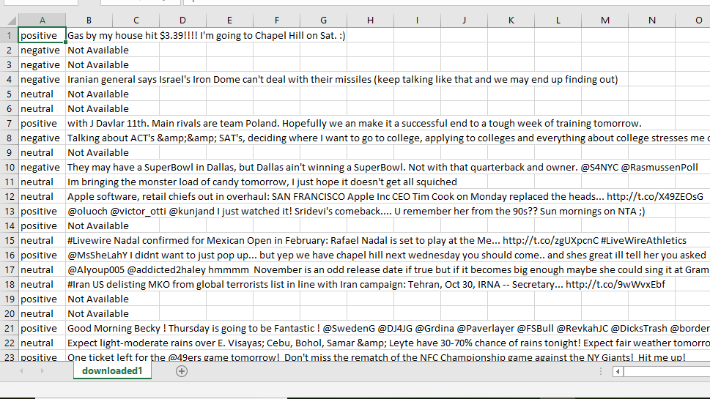
1.Data-Collection
The dataset was collected from SemEval-10 and saved as a csv file.It consists of tweets and their corresponding classes.

Slide 7
2.Data Pre-processing
Pre-processing of data is done to remove all the noise and insignificant words from our dataset.
Removal of rows which says ‘Not-Available’ from the data(if any)
Dataframe from pandas
Using nltk
Removing stop words(stopwords)
Stemming(Porterstemmer() )
Lemmatization(WordNet database)
Using string.punctuation
Removing punctuation
Removing @ symbols
Label Encoding for the classes (sklearn’s LabelEncoder() )
Train-Test split(sklearn’s train_test_split)

Slide 8
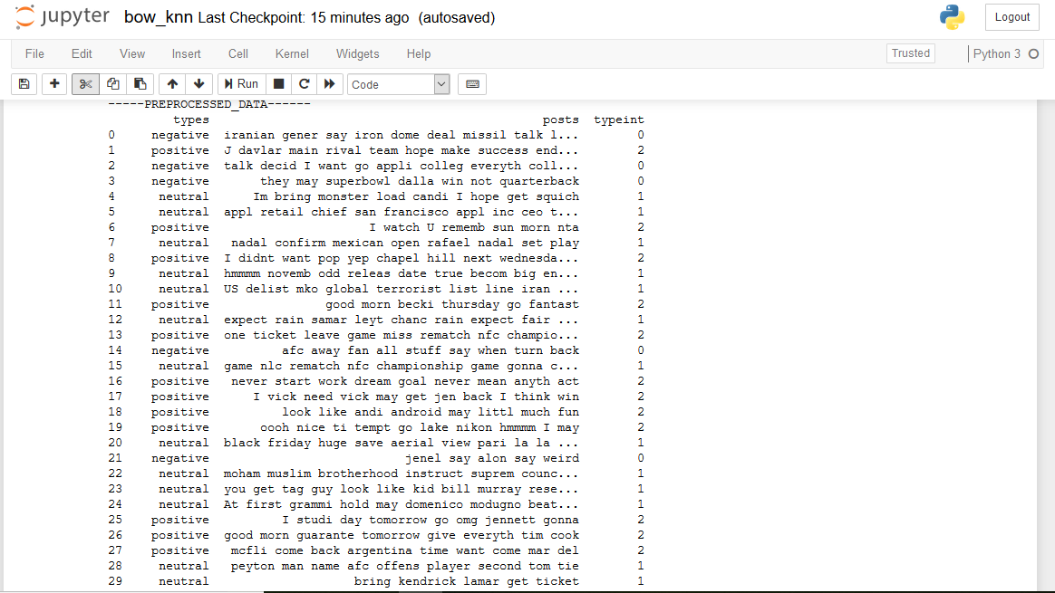
Pre-processed Data

Slide 9
3.Feature-Extraction and Selection
Selection of useful words from the dataset is called as feature extraction.
Feature Extraction with Bag of Words
Bag of Words (BOW) is a Natural Language Processing method to extract features from text documents. These features can be used for training machine learning algorithms. It creates a vocabulary of all the unique words occurring in all the documents in the training set.
Tokenization,counting,normalization.
Generated vectors can be input to the machine learning algorithm.

Slide 10
A BoW representation
 | token1 | token2 | token3 |  |  |  |  | token-n
tweet1 | 0 | 1 | 2
ttweet2 | 1 | 2 | 1
tweet3
tweet-m

Slide 11
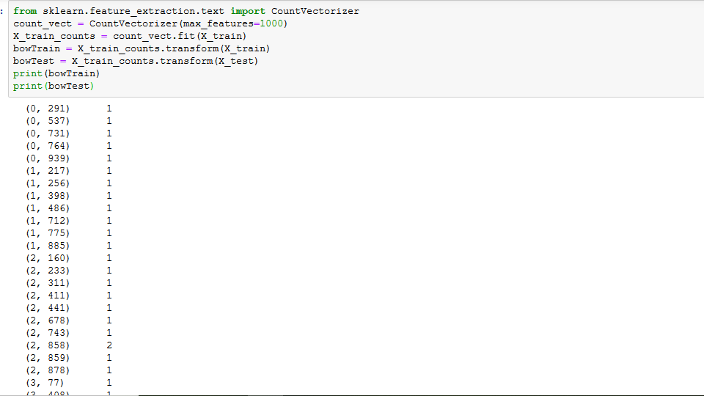
After applying BoW to get test-train set in vector form

Slide 12
5.Classification
Classification is done by using Machine learning algorithms.Machine learning is the study of algorithms that can learn from and make predictions on data. Some of the algos are:KNN,SVM,Naive-Bayes,MLP,etc,.
Classification using K-Nearest Neighbours
KNN can be used for both classification and regression predictive problems. However, it is more widely used in classification problems in the industry.It is commonly used for its easy of interpretation and low calculation time.

Slide 13
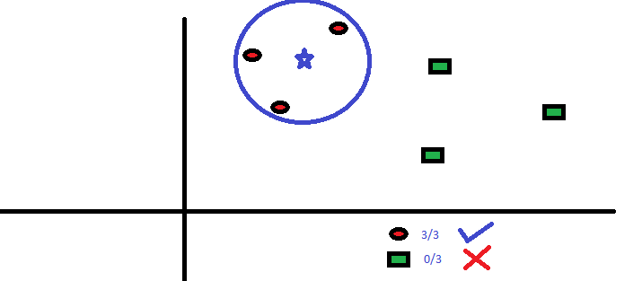
KNN Visualisation

Slide 14
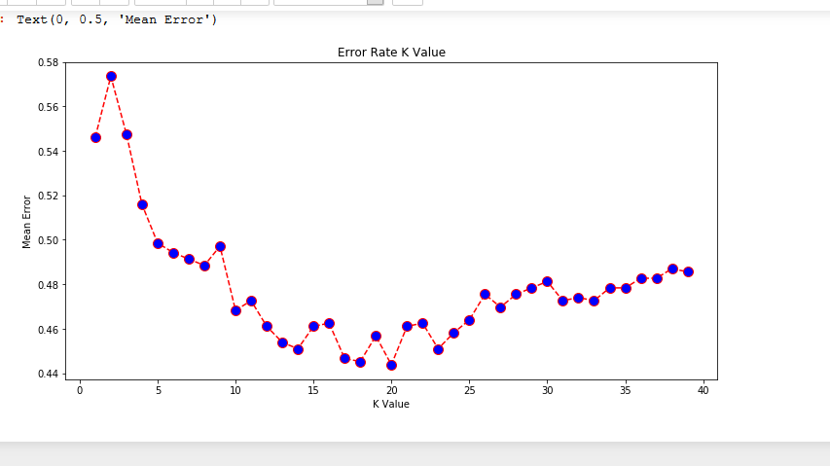
Optimum K Value

Slide 15
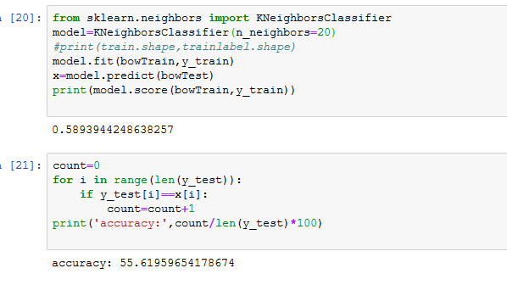
Predictions and Result

Slide 16
Challenges
People express opinions in complex ways.
In opinion texts, lexical content alone can be misleading.
Intra-textual and sub-sentential reversals, negation, topic change common..
Rhetorical devices/modes such as sarcasm, irony, implication, etc.

Slide 17
Future-Scope
Sentiment analysis is an emerging field in decision making process and is developing fast.
The development of techniques for the document-level sentiment analysis is one of the significant components of this area.
Less to do with improving the accuracy of the algorithms, but instead focus on the area of determining where you can correlate sentiment with behavior.

Slide 18
Thank You

